Slide 1
User role based access and authorization
Deshamone praveen kumar

Slide 2
Main Modules
Modules
Login page
Signup page
users
admin

Slide 3
Overview
Main Point
Project is for gaining knowledge and applying what you know.
User role based access and authorization was done by each and every member in the group. Since it’s a small project everone involved.
My part
Summarising the idea and what modules to do and linking with the database and also some code part

Slide 4
overview
Giving access to user according to there role.
According to the role of the user resources or permissions will be changed.
It helps in securing the data.

Slide 5
Signup page
Main Point
Users or admin can register with prefer username and password.
Users can be added from the backend.

Slide 6
Login page
Main Point
users can login using the registered username and password.
Admin can login using registered username and password.

Slide 7
Admin page
Main Point
He has different view than user
He has different permissions or access than users

Slide 8
users page
Main Point
He has different view than admin.
He has different permissions or access than admin

Slide 9
Tools
Spring using java
MongoDB
Java Servlet pages
Css

Slide 10
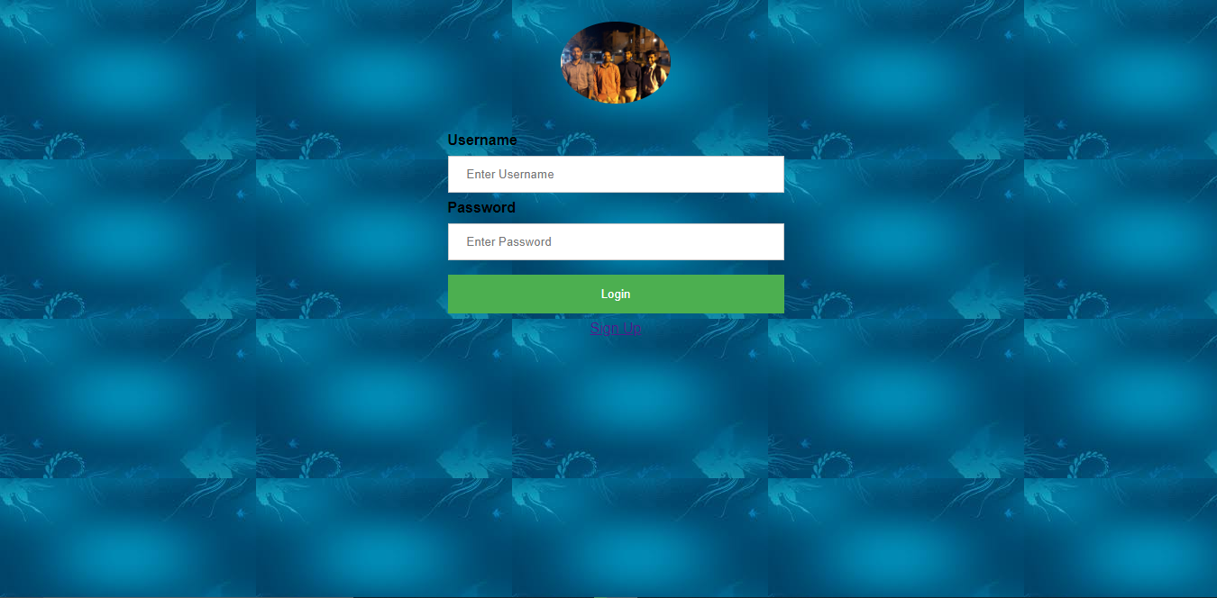
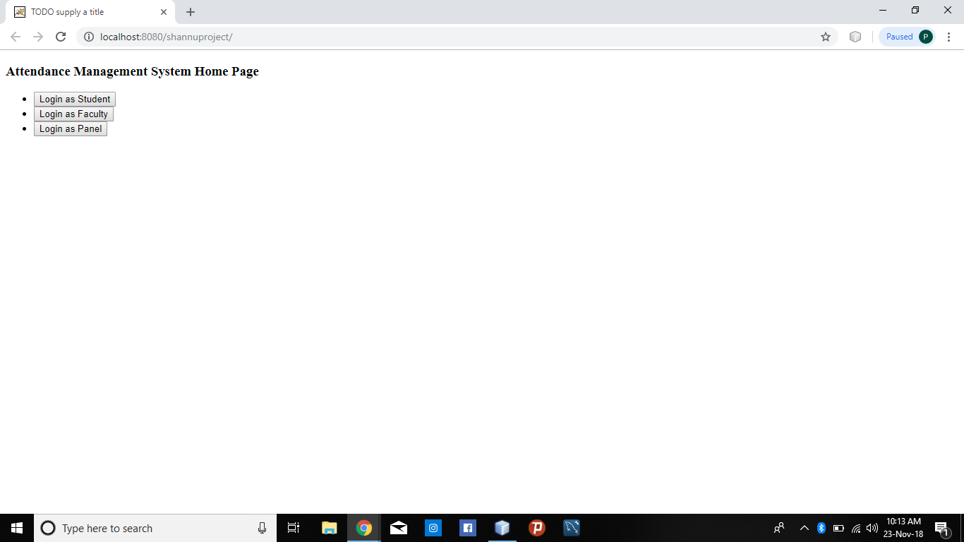
Our Home Page

Slide 11
Thank you
Deshamone praveen kumar
Praveen kolla
Guru vishnu
Sai Krishna
Manidep

